Slide 1
Class X
Introduction to Bayesian statistics

Slide 2
Why Bayesian

Slide 3
INTRODUCTION
Bayesian statistics have become increasingly popular in many fields of research
But why?
What’s so special about this Bayes guy?

Slide 4
What’s in a probability?
Frequentists stats and beaysian stats differ in terms of their definition of what is a probability
This is at the heart of the differences between these two approaches
It also changes how one interprets the results they get!
While both methods have their merits, pros, and cons one must ask what KIND of question they are trying to answer first BEFORE preforming the analysis

Slide 5
What’s in a probability?
In frequentist statistics, probability is seen as the long run frequency of an event, parameters are treated as fixed while data are seen as random, and the interpretation of estimates rests on the assumption of repeated sampling which is almost never satisfied.
In Bayesian statistics, probability is seen as a degree of belief, data are treated as fixed while parameters are assigned distributions, and the result of an analysis is a posterior distribution (Jackman, 2009).

Slide 6
Bayes theorem
Bayes theorem is a way to quantify the probability of an event given prior knowdlegde about said event
e.g. the probability that it is currently charismas might change with the prior knowdlege of what kind of music is playing on the radio
Baysian statistics follow from the following theorm which describes how to compute the porbaility of an event given prior knowledge

Slide 7
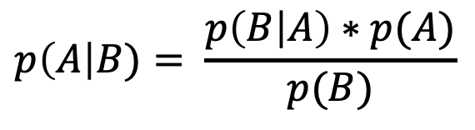
Bayes theorem
$$p\left(A\right|B)= \frac{p\left(B | A\right)∗p(A)}{p(B)}$$
Where:
p(A|B) is the conditional probability of A given B (i.e., the posterior)
p(B|A) is the conditional probability of B given A (i.e., the likelihood)
p(A) & p(B) are the probabilities of A and B, these are the marginal probabilities (i.e., priors)

Slide 8
Let’s see an example

Slide 9



Monty Hall problem

Slide 10
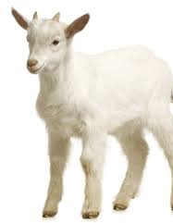
Monty Hall problem

Slide 11


Monty Hall problem

Slide 12
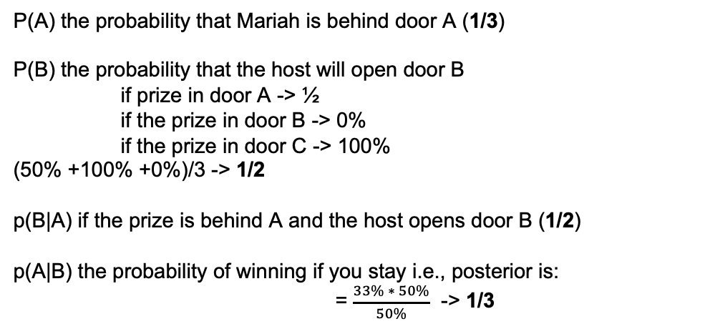
Monty Hall Problem
P(A) the probability that Mariah is behind door A (1/3)
P(B) the probability that the host will open door B
if prize in door A -> ½
if the prize in door B -> 0%
if the prize in door C -> 100%
(50% +100% +0%)/3 -> 1/2
p(B|A) if the prize is behind A and the host opens door B (1/2)
p(A|B) the probability of winning if you stay i.e., posterior is:
= $\frac{33\% ∗ 50\%}{50\%}$ -> 1/3

Slide 13
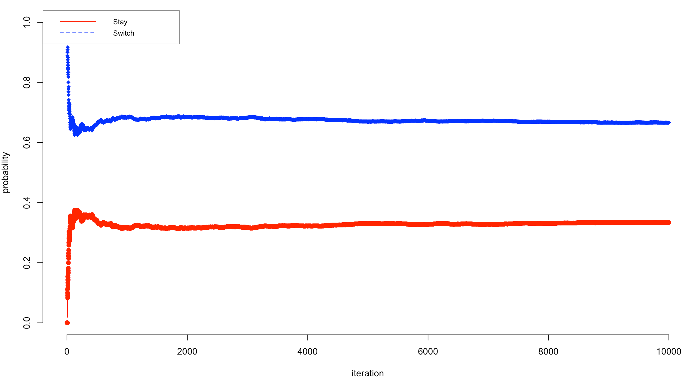
Monty Hall Problem
See simulation code for example of long-run probability of prize being behind each door (i.e., the frequentists interpretation of this problem)

Slide 14
Computing Bayes Theorem

Slide 15
Bayes theorem
$$p\left(A\right|B)= \frac{p\left(B | A\right)∗p(A)}{p(B)}$$
Where:
p(A|B) is the conditional probability of A given B (i.e., the posterior)
p(B|A) is the conditional probability of B given A (i.e., the likelihood)
p(A) & p(B) are the probabilities of A and B, these are the marginal probabilities (i.e., priors)

Slide 16
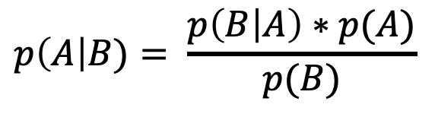
Example of Bayes theorem
 | Negative | Positive
Tests Neg | True Negative | False negative
Test Pos | False Positive | True Positive
$$p\left(A\right|B)= \frac{p\left(B | A\right)∗p(A)}{p(B)}$$
Suppose covid tests have a true positive rate of 0.9 and a true negative rate of 0.8 (see table)
Assuming a base rate of 0.02 of covid in the population, what is the probability that someone with covid has covid?

Slide 17
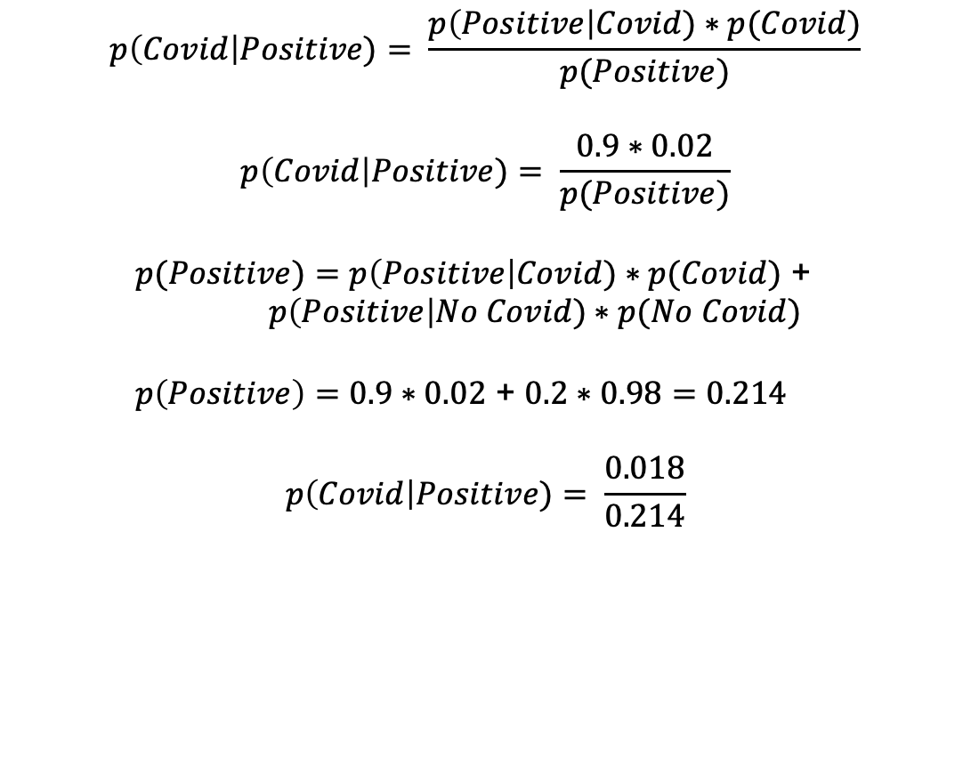
Example of Bayes theorem
$$p\left(Covid\right|Positive)= \frac{p\left(Positive\right|Covid)∗p(Covid)}{p(Positive)}$$
$$p\left(Covid\right|Positive)= \frac{0.9∗0.02}{p(Positive)}$$
$p(Positive)=$ $p\left(Positive\right|Covid)∗p(Covid)$ + $p\left(Positive\right|No Covid)∗p(No Covid)$
$p\left(Positive\right)=0.9∗0.02$ + $0.2∗0.98=0.214$
$$p\left(Covid\right|Positive)= \frac{0.018}{0.214}$$

Slide 18
Bayes theorem
$$p\left(A\right|B)= \frac{p\left(B | A\right)∗p(A)}{p(B)}$$
Where:
p(A|B) is the conditional probability of A given B (i.e., the posterior)
p(B|A) is the conditional probability of B given A (i.e., the likelihood)
p(A) & p(B) are the probabilities of A and B, these are the marginal probabilities (i.e., priors)

Slide 19
Prior beliefs change everything

Slide 20
Priors are KEY
One of the first questions you may ask yourself before you start a Bayesian analysis is:
What are my prior beliefs?

Slide 21
Priors are KEY
The selection of priors are very important and at the heart of the Bayesian approach
Some suggest to go to the literature for priors… assuming there are enough studies on a similar topic
You can also collect two samples/ experiements to inform one another (but what about combining to make one larger sample?)

Slide 22
Priors are KEY
One approach has been to give an initial analysis uninformative priors (e.g., a uniform distribution)
Uniform priors are most useful when parameters have a limited range
Gaussian uninformative priors are useful when you do not know the value your parameter may take (remember to scale)

Slide 23
Priors are KEY
There are many approaches and choices of prior beliefs…
None are better than the other because each serve a purpose
The best thing you can do is report and be transparent about your priors and provide enough info that people can use your posteriors as their priors (pay it forward)

Slide 24
Bayes theorem
$$p\left(A\right|B)= \frac{p\left(B | A\right)∗p(A)}{p(B)}$$
Where:
p(A|B) is the conditional probability of A given B (i.e., the posterior)
p(B|A) is the conditional probability of B given A (i.e., the likelihood)
p(A) & p(B) are the probabilities of A and B, these are the marginal probabilities (i.e., priors)

Slide 25
Computing posteriors

Slide 26
Analytical solutions
Closed-form expressions in mathematics are math problems that can be expressed with a FINITE number of operations
Analytical expressions are expressions that lend themselves to calculations (i.e., we can compute the value)
In Bayesian stats, posteriors often do not have analytical solutions, and need numerical solutions (i.e., our best guess of what the answer is)

Slide 27
MCMC sampling
Markov Chain Monte Carlo is a class of algorithms used for sampling distributions. They are used as common numerical solutions in Bayesian stats

Slide 28
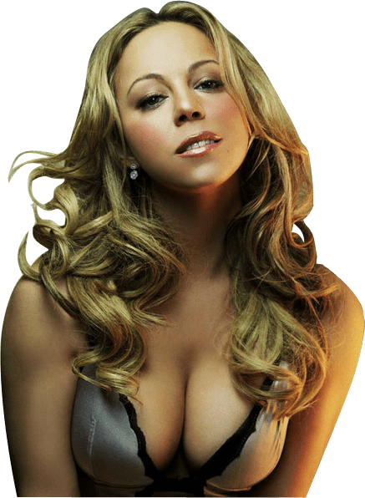


Markov Chains
Markov Chains are models in mathematics whereby the current state depends only on the previous state
They have interesting properties, and in the long run converge

Slide 29
Tips on MCMC sampling
MCMC sampling can take long and fail to converge, statisticians have developed tips to help:
Number of Steps: how many iterations of MCMC sampling (i.e., num of samples)
Burn-in: throwing away the first X number of samples
Thinning: only keeping every X sample

Slide 30
Tips on MCMC sampling
Number of Steps: helps converge to the proper value, specially for slow converging chains
Burn-in: first samples are biased, we usually remove them to help converge
Thinning: helps remove auto-correlation of samples

Slide 31
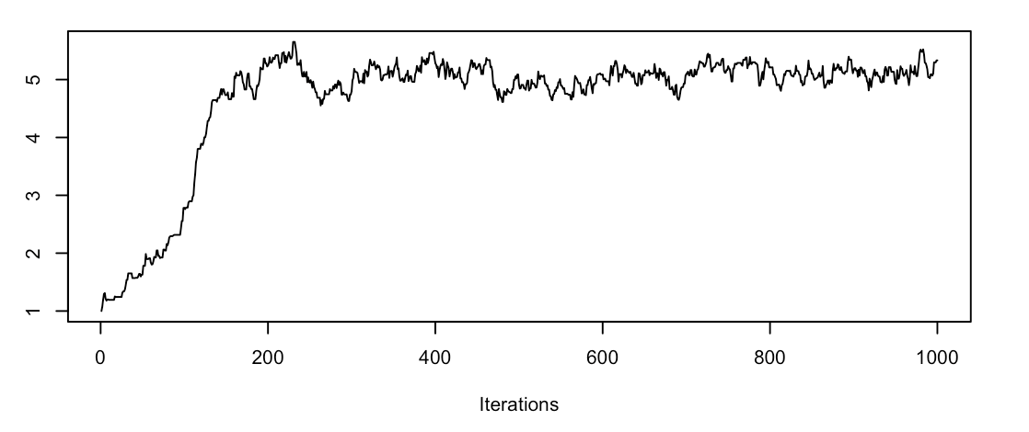
Interpreting MCMC outputs

Slide 32
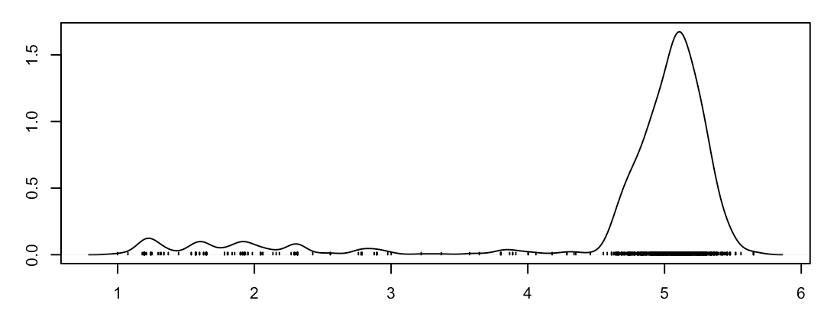
Interpreting MCMC outputs

Slide 33
Interpreting MCMC outputs
BURN IN

Slide 34
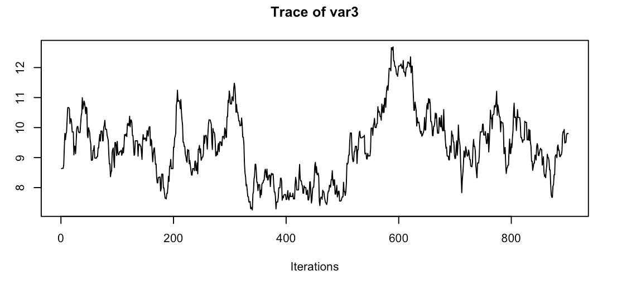
Interpreting MCMC outputs

Slide 35
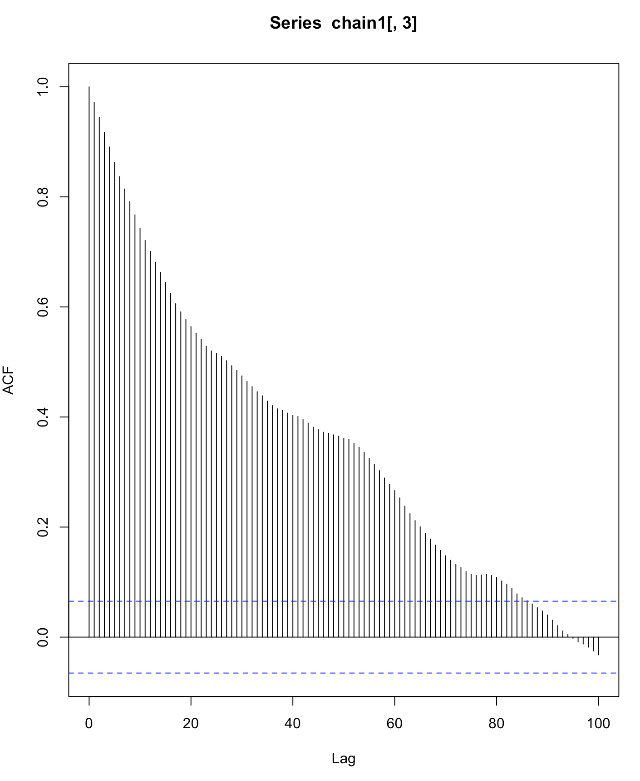
Interpreting MCMC outputs
MCMC produces samples that are highly correlated to one another, high auto-correlation
When this is too high, samples fail to explore the entire range of the parameter space (i.e., get stuck)

Slide 36
Interpreting MCMC outputs
Thinning is one strategy to fix this where you only keep the ith sample taken from MCMC
Some argue that this is not useful, and instead you should take a longer chain instead

Slide 37
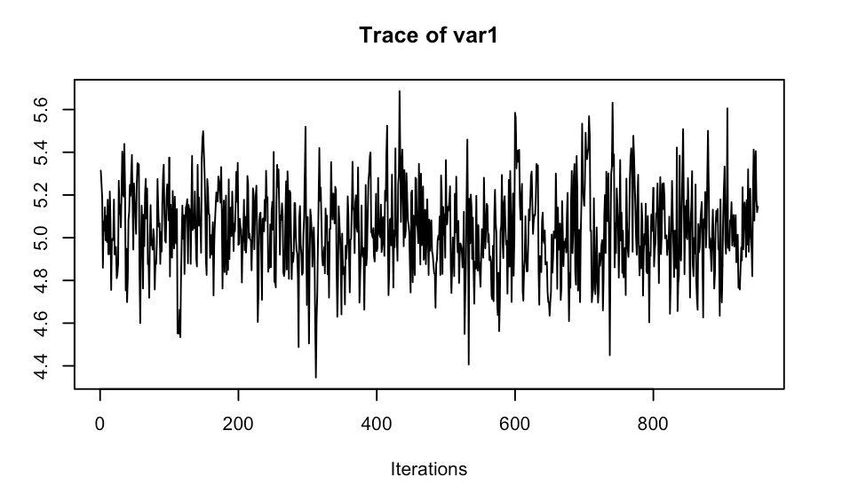
Interpreting MCMC outputs

Slide 38
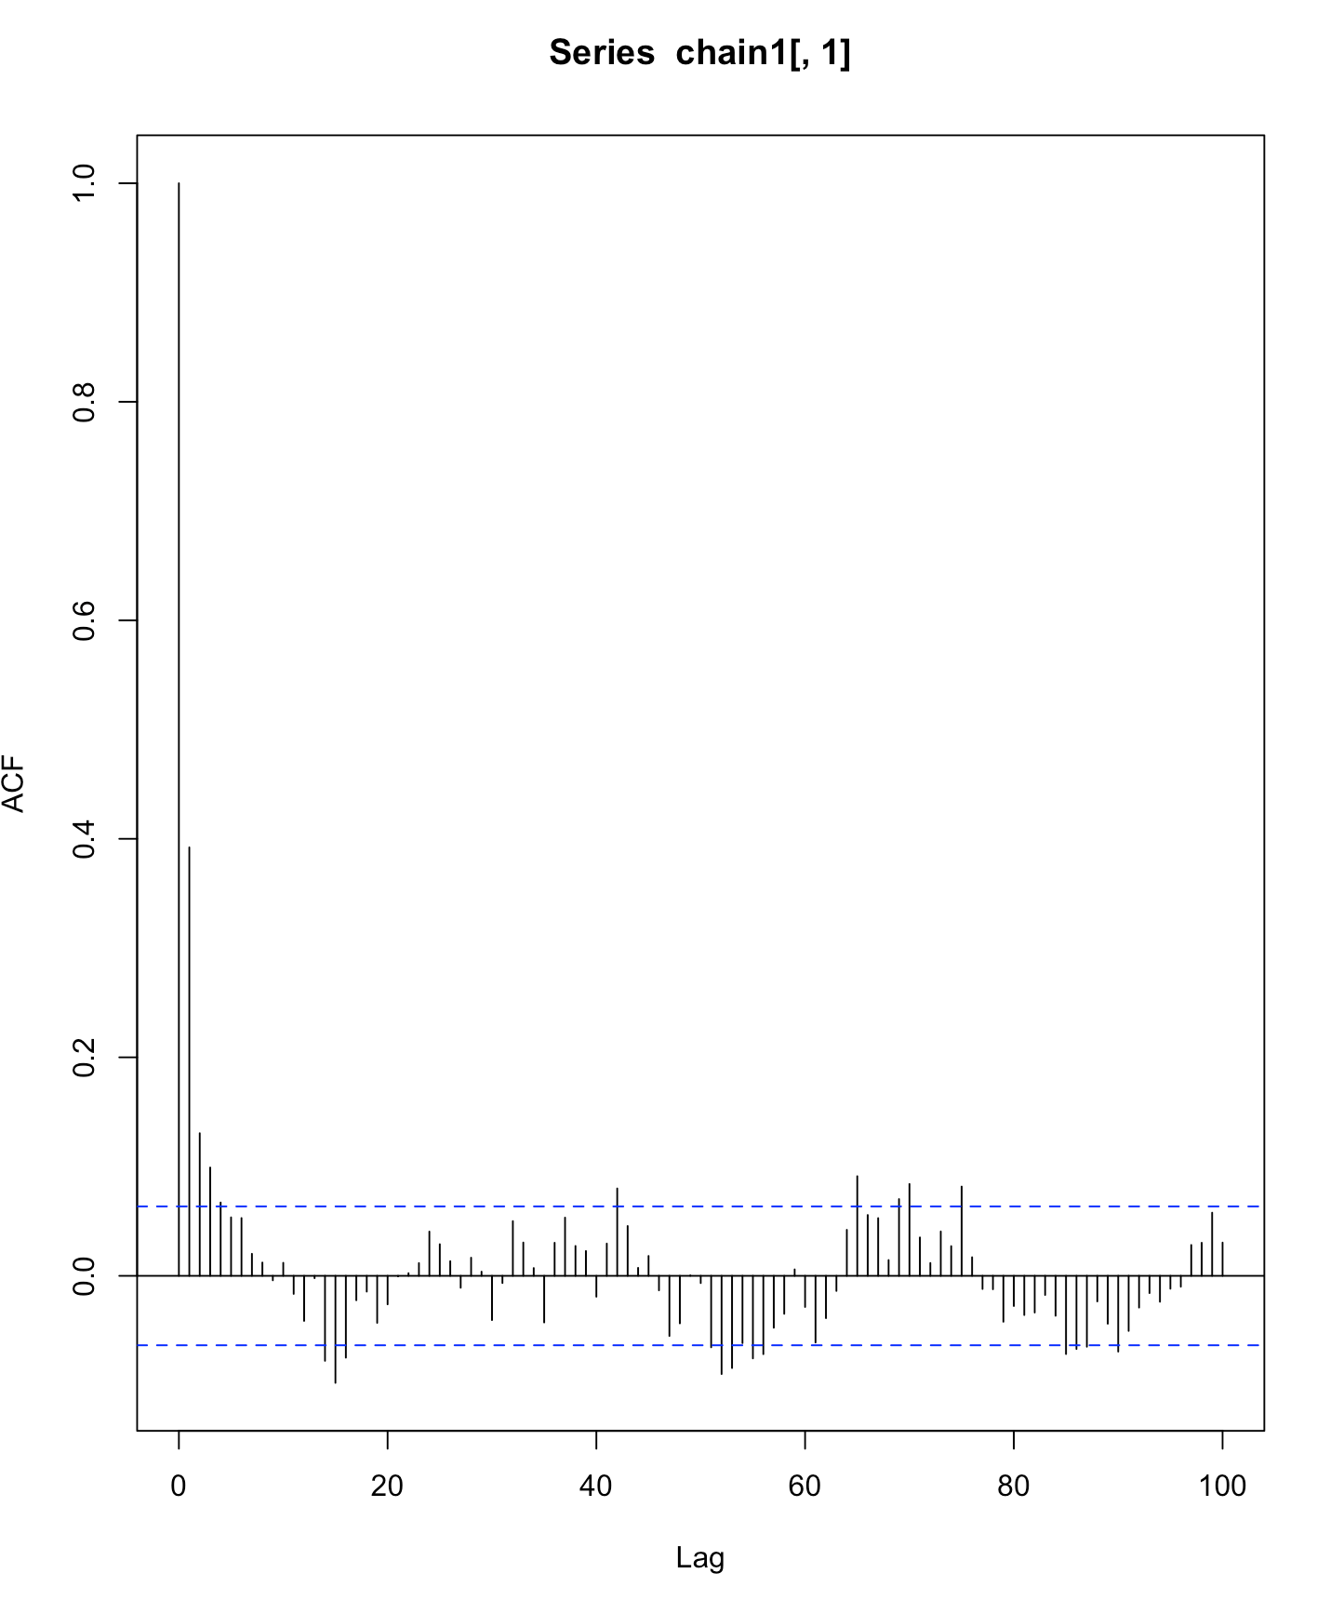
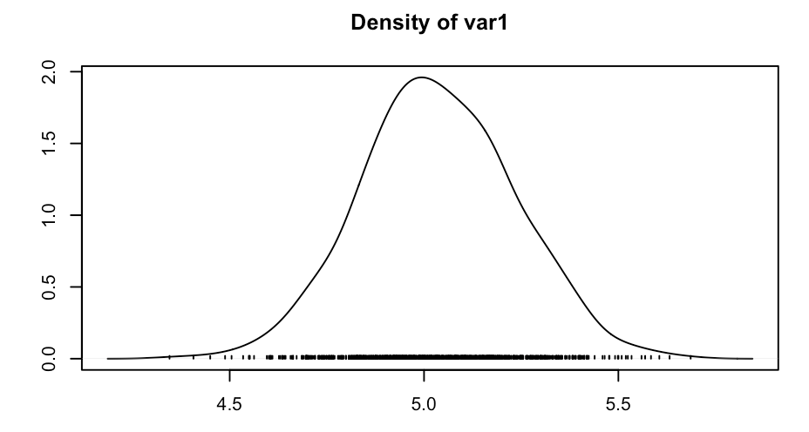
Interpreting MCMC outputs

Slide 39
Bayesian T-test

Slide 40
The BEST test
T-tests are used to compare two groups (see stats lecture for details)
A Bayesian t-test implements the principles of bayes theorem to compute the posterior distribution representing the difference between the two groups

Slide 41
The BEST test
Bayesian tests allow you to provide credible parameter values (in the form of a posterior distribution)
This allows you to make the decision about its value and meaning
It also by extension, allows you to assess evidence for the null hypothesis

Slide 42
The BEST test
“In Bayesian estimation, we reallocate belief toward the parameter values that are consistent with the data and away from parameter values that are inconsistent with the data. ”

Slide 43
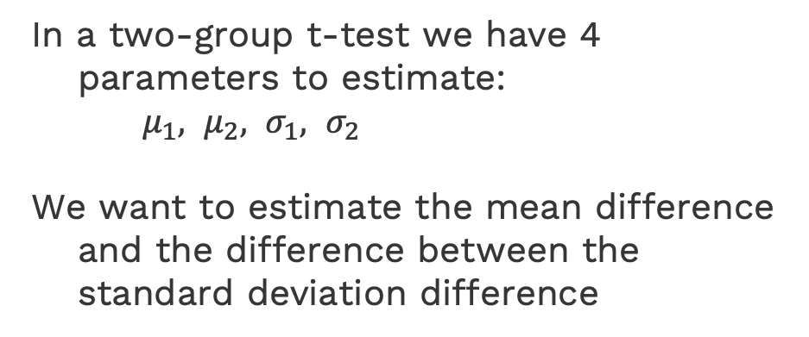
The BEST test
In a two-group t-test we have 4 parameters to estimate:
$μ_{1}, μ_{2}, σ_{1}, σ_{2}$
We want to estimate the mean difference and the difference between the standard deviation difference

Slide 44
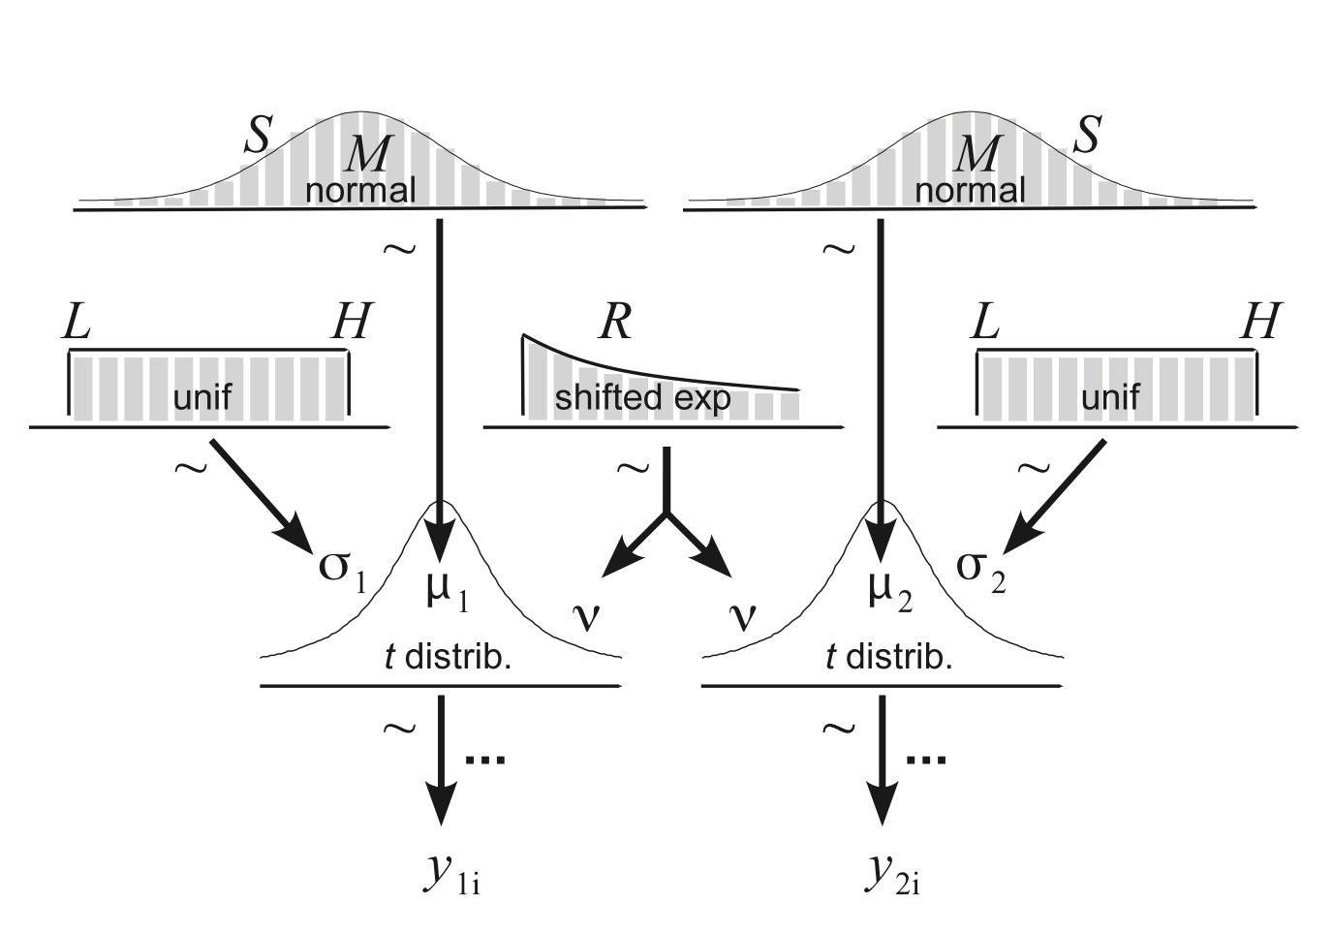
The BEST test

Slide 45
The BEST test
MCMC sample these 5 parameters

Slide 46
The BEST test
BEST package implements the Bayesian t-test returning the posteriors of each of the parameters of interest and their HDI
See code for examples

Slide 47
Highest Density Interval
95% HDI or 95% credible interval provides us with a range where our parameter is likely to exist
It represents the region of a parameter distribution with the highest probability density
“the 95% most credible values of the parameter.”
Can be used in making decisions (i.e., like a p value in frequentist stats)

Slide 48
Region of Practical Equivalence
ROPE intervals allow us to make decisions based on the posteriors and even accept the null
ROPE is a range of parameter values that are equivalent to the null (e.g., practically zero)
Should be specified BEFORE you look at your data

Slide 49
Region of Practical Equivalence
ROPE HDI decisions allow you to accept or reject the null based on posterior estimates
If the parameter HDI falls COMPLETELY in the ROPE then accept the null
If the parameter HDI falls COMPLETELY outside the ROPE then reject the null

Slide 50
Region of Practical Equivalence
Binary decisions can be a slippery slope:
They ignore the distribution of the data and the confidence (i.e., how narrow the HDI is) in an estimate
They also lead to black and white thinking, when the principle of Bayes stats is to quantify changes in BELIEF

Slide 51
Region of Practical Equivalence
“In other words, “accepting” a landmark value means that the parameter value is practically equivalent to the landmark value, not that the parameter value is the landmark value. ” Kruschke, 2018

Slide 52
Region of Practical Equivalence
Beyond using Bayesian stats to make binary decisions like in frequentist stats, you estimate distributions of parameters
This means you can quantify the probability that your parameter values is above, below, or within, a specific range which may be helpful in some research questions (i.e., probability that a value is positive <0)

Slide 53
Linear Regressions

Slide 54
Linear Regressions
The idea of using Bayes theorem and MCMC sampling can be extended to more complex models
Packages in R have made this process easier

Slide 55
A note on samplers
JAGS, BUGS, and stan are coding languages used to sample parameters of your model
R offers many packages which allow you to specify (pretty) flexible models WITHOUT having to learn to code these languages
We will not cover how to code in JAGS (see resources for help) but focus on the R packages that allow you to work around this

Slide 56
Linear Regressions
Just like the Bayesian T-test, we define parameters we wish to estimate using Bayes theorem and then apply MCMC sampling to estimate their posteriors
We thus can interpret the outputs of the beta coefficients (see stats lecture for details about regressions)

Slide 57
rstanarm

Slide 58
Linear Regressions
The rstanarm package allows you to specify Bayesian regressions in the R syntax and runs the code in stan
This works much like discussed in previous stats lecture

Slide 59
Linear Regressions

Slide 60
Logistic Regressions

Slide 61
R Hat statistic
Is a statistic that is useful in determining if your MCMC has failed to converge:
It answers the question: do my chains converge to the same value?
Rhat is a ratio of within-chain and across all chain variance
Rhat > 1.1 indicates generally poor convergence

Slide 62
bmrs

Slide 63
Hierarchical Regressions
Heirarchical regressions take into account the nesting of data by fitting additional random variables
The brms package in R allows you to specify hierarchical regressions in the same lme format (see stats lecture)
Provides posterior desnities of estimated parameters

Slide 64
Hierarchical Regressions

Slide 65
Hierarchical Regressions

Slide 66
Bayes factor
Bayes Factors provide rough estimates of how much evidence there is for the alternative vs null model
You can compute Bayes Factors using frequentist models (i.e., lme models) and do not need to fit a Bayesian regression

Slide 67
Bayes factor
Bayes Factors are a means to preform Bayesian Model Selection
BFs are computed as the ratio of evidence for the alternative over the eveidnece for the null hypothesis

Slide 68
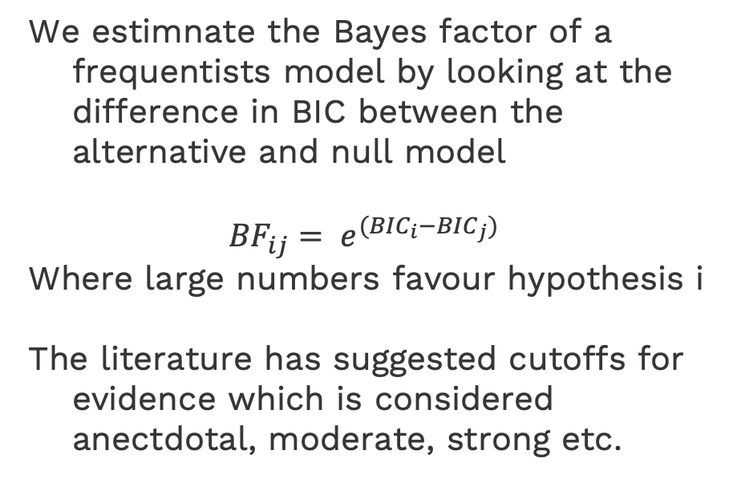
Bayes factor
We estimnate the Bayes factor of a frequentists model by looking at the difference in BIC between the alternative and null model
$${BF}_{ij}= e^{({BIC}_{i}−{BIC}_{j})}$$
Where large numbers favour hypothesis i
The literature has suggested cutoffs for evidence which is considered anectdotal, moderate, strong etc.

Slide 69
THANKS!

Slide 70
Resources
https://www.statlect.com/fundamentals-of-statistics/Markov-Chain-Monte-Carlo-diagnostics
https://cran.r-project.org/web/packages/BEST/vignettes/BEST.pdf
https://jkkweb.sitehost.iu.edu/articles/Kruschke2013JEPG.pdf
https://www.youtube.com/watch?v=fhw1j1Ru2i0
http://journals.sagepub.com/doi/10.1177/2515245918771304

